Slide 1
Towards equitable and sustainable cities with integrated facility and transport planning
Urban congestion arises from hierarchical facilities within cities
How accessibility determines urban transit ridership

Slide 2
1. Urban congestion arises from hierarchical facilities within cities

Slide 3
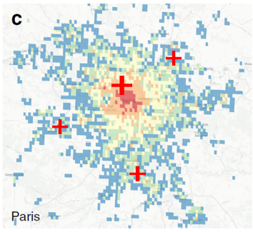
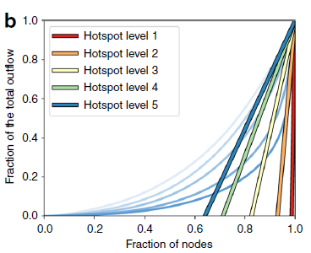
Hierarchical facility
Fraction of total visits
visits
Fraction of hospitals
Visits: Top10%/Bottom10 = 567.27
Population: Top10%/Bottom10 = 9.49

Slide 4
Congestion indicator
Congestion is a result of an imbalance of the travel demand and the transport system supply.
Demand. The congested demand results from the concentration of visits in space and time.
Demand-induced congestion can be defined by Gini index of visits in space over a period.
Supply. The supply is constrained by the historical shape of the infrastructure, the level of investment, transport management and operating practices.
hospital

Slide 5
Contribution analysis - Remove the facility and re-evaluate the congestion level (gini index)
 | Removing | Congestion potential | 95% CI
Hospital | 0 1% 10%
School | 0 1% 10%
Museum | 0 1% 10%
Park | 0 1% 10%

Slide 6
Optimize facility hierarchy to mitigate congestion potential
1. Existing facilities: Equalize to minimize hierarchy
Facility hierarchy = resident population hierarchy (No. of visits that within 2km)
2. New facilities: Add new facilities to locations that requires facilities
Adjusted P-median problem

Slide 7
2. How accessibility determines urban transit ridership

Slide 8

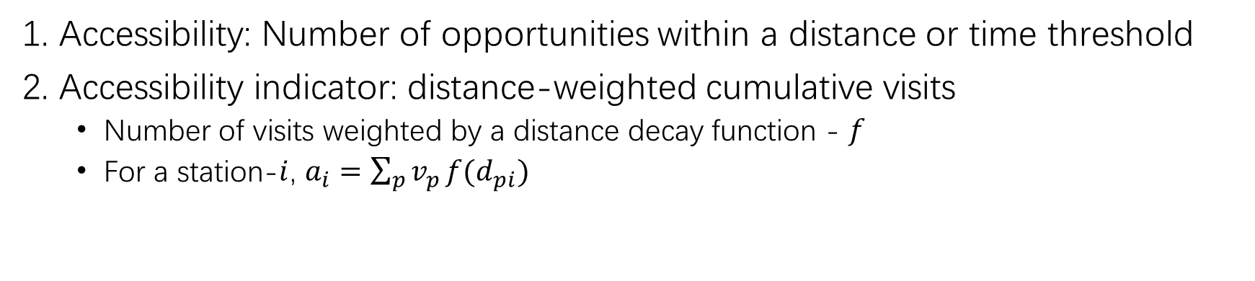

Accessibility (local-level)
1. Accessibility: Number of opportunities within a distance or time threshold
2. Accessibility indicator: distance-weighted cumulative visits
Number of visits weighted by a distance decay function - $f$
For a station-$i$, $a_{i}=\sum_{p}{v_{p}}f(d_{pi})$
1. Residency accessibility
2. Facility accessibility
CBG
POI
station-$i$
station-$i$

Slide 9
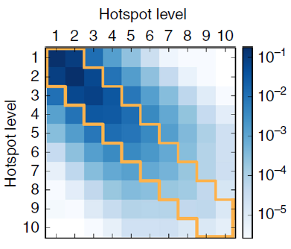



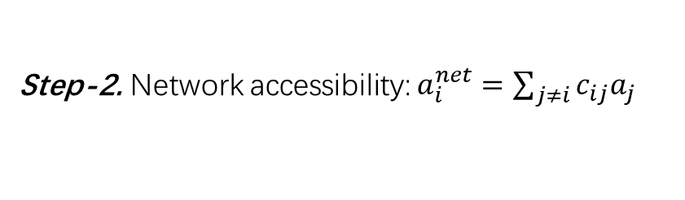
Accessibility (network level)
station-$i$
CBG
Trip
Resident housing
Subway line
Station
station-$j$
Station
Step-1. $c_{ij}:$ Correlation between station-$i,j$
Facilities
Step-2. Network accessibility: $a_{i}^{net}=\sum_{j≠i}{c_{ij}a_{j}}$

Slide 10
Accessibility vs. transit ridership
Analysis methods
Regression analysis
Network correlation analysis
Data used
Sectional data analysis
Use data at single time point (single year)
Time series data analysis
Use data from multiple time points

Slide 11
Can we improve transit ridership by relocate key facilities?
Local-level accessibility maximization
Relocate key facilities around subway stations
Network-level accessibility maximization
Relocate key facilities around subway stations
Add new subway stations to the locations with high facility accessibility but with no station

Slide 12
Local-level accessibility vs. ridership
Station Ridership (Y)
Accessibility (X)

